Slide 1
Mitigating Unfairness and Bias in Cold Start Recommenders
By Team 17
Kumsetty Nikhil Venkat - 181IT224
Amith Bhat Nekkare - 181IT105

Slide 2
ABSTRACT
Till date, attempts to study bias and fairness in recommender systems have focused on improving fairness and mitigating bias in situations where a history of the item already exists. In this project, we explore the bias against new items without any feedback history which are added to recommender systems.
For this purpose, we implement two models to mitigate bias, by using fairness measures such as equal opportunity and Rawlsian Min-Max scores and incorporating them into our models. We train and test our model over the ML1M dataset, and achieve favourable results over the base paper.

Slide 3
INTRODUCTION
Recommender systems are important for connecting users to the right items. These systems are used in many places, such as Amazon’s product recommender system, Netflix’s movie recommender system, etc.
However, a challenge associated with recommender systems is ensuring the fairness of the recommendations. For example, in a product recommender, how do we ensure the recommender gives equal treatment to products from big companies and products from new entrants ? Unfairness in recommendation may lead to potential negative impacts to user satisfaction, the recommendation platform itself, etc.

Slide 4
INTRODUCTION
Previous works have revealed that widely used recommendation algorithms can indeed produce unfair recommendations toward different items. In this scenario, they show that the main driver of unfairness is the data bias in historical feedback (like clicks or views), and recommendation algorithms unaware of this bias can inherit and amplify this bias to produce unfair recommendations.
We know that the data bias can be transferred from warm start items to new items through item content features due to the nature of machine learning algorithms.

Slide 5
INTRODUCTION
This fairness gap can be especially problematic since unfairness introduced by cold start recommenders will be perpetuated and accumulated through the entire life cycle of an item, resulting in growing difficulty for mitigating unfairness as the life cycle goes on.
One significant obstacle we face is the issue of formally defining fairness. How exactly should we quantify the concept of fairness? In this work, we follow two well-known concepts – equal opportunity and Rawlsian Max-Min fairness principle, and incorporate these concepts in our models.

Slide 6
INTRODUCTION
By following equal opportunity to measure fairness by the true positive rate, the fairness is directly aligned with the feedback or economic gain items receive as well as user satisfaction. The TPR is defined as the ratio of number of accurate recommendations made of items to users who will like it, to the total number of recommendations made.
By following Rawlsian Max-Min fairness to accept inequalities, the fairness does not require decreasing utility for the better-served items and thus can better preserve the overall utility.

Slide 7
Motivation
To create an equitable recommender system which gives fair recommendations to users even when there is no input about the new items.

Slide 8
LITERATURE REVIEW
Paper & Author | Work Done
Burke et al. [1] (2017) | Mostly concentrated on the rating prediction tasks. Also explored fairness and unfairness in the ranking of an item by calculating the differences in the rating distributions predicted by recommenders across item groups.
Kamishima et al. [2] (2017) | Evolved into using a score concept of fairness among items using regularization based methods of evaluation of fairness in recommenders.
Prost et al. [3] (2019) | Proposed a new algorithm which investigated fairness in item rankings directly than on the predicted scores which were more intermediary in nature.
Ziwei et al. [4] (2021) | Introduced the innovation of cold start recommender systems.

Slide 9
OUTCOME OF LITERATURE REVIEW
In our literature review, we found that most papers in the domain of recommender systems focussed on improving fairness in the warm start scenario ( in the middle of an item’s life cycle in the recommender). On the other hand, we focus on the cold start scenario (during the start of an item’s life cycle)

Slide 10
PROBLEM STATEMENT
To implement two machine learning models to improve the fairness in the ranking of and mitigate bias in recommenders in the cold start scenario.

Slide 11
METHODOLOGY
Develop a model to learn a transformation from item content feature of warm start items to user-item interactions between warm start users and items during training.
Apply the learned transformation process to the content feature of a new item to predict the possible interactions between users and new items as a recommendation during testing.
For this purpose we will use mainly 2 types of approaches
Joint-learning Generative Method
Score Scaling Method

Slide 12
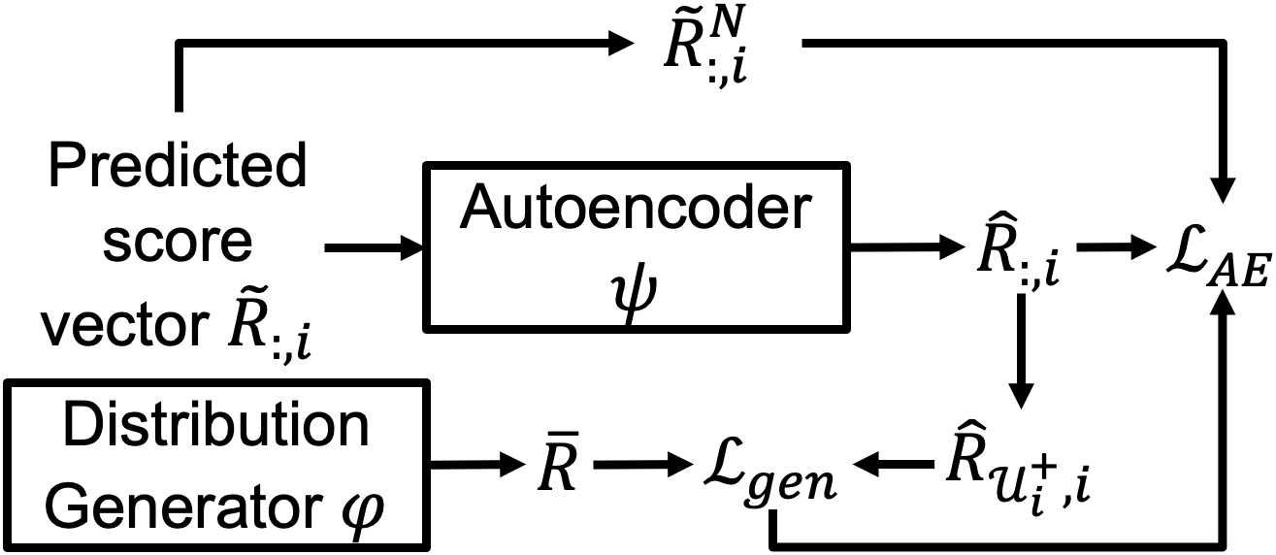
METHODOLOGY
Joint-learning Generative Method:

Slide 13
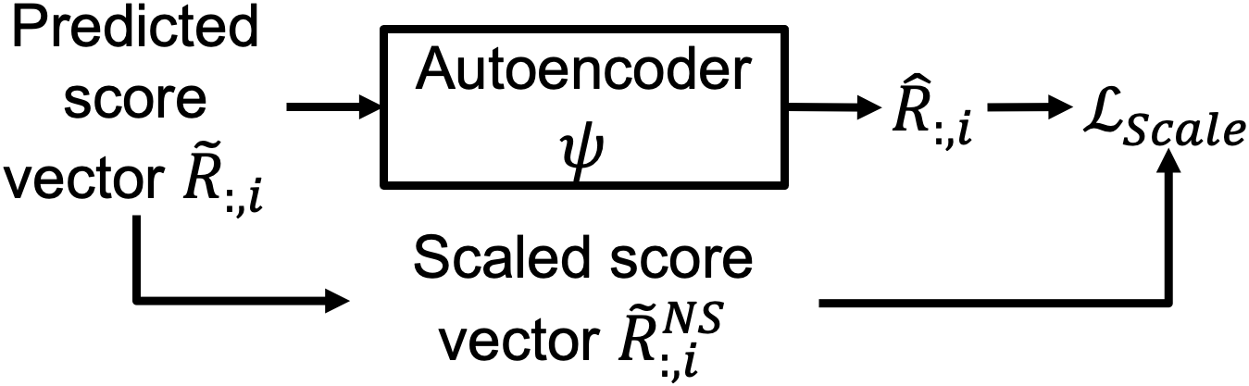
METHODOLOGY
Score Scaling Method:

Slide 14
WORK DONE
We pre-processed the ML1M dataset.
We have implemented the joint-learning generative, and the score-scaling models. It was run on the preprocessed ML1M dataset.
Analysed the obtained results and optimized the gen and scale model to produce optimal results.

Slide 15
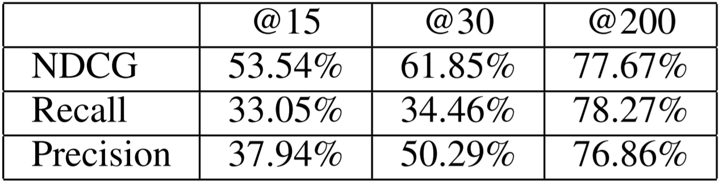
Results and Analysis - gen method
We observe that from the results obtained the score scaling model is performing better than joint-learning generative method. hence, by decreasing the popularity bias in the cold start recommendation system the recommenders ranking of the new items has improved greatly.
We also observe that the joint-learning generative method greatly helped in improving the fairness of the recommendation of new items.
RESULTS OF JOINT-LEARNING GENERATIVE METHOD

Slide 16
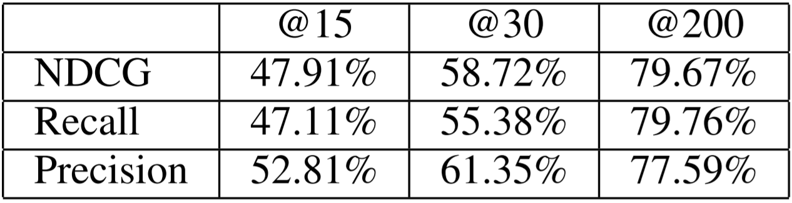
Results and Analysis - scale method
The item-view utility improvement in score scaling method is due to that items originally under-served by base models receive more utility from the two proposed models, leading to the improvement of overall item-view utility even though the best-served items receive lower utility.
RESULTS OF SCORE SCALING METHOD

Slide 17
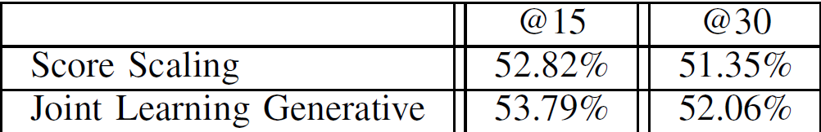
NOVELTY
We implemented Dropout-Net based mitigating factor and RNN to to make use of each user’s recommendation by feeding it into an RNN in the Auto-encoder component. Hence, we observed fairly better results that the base paper.
We also run the models with k=200 ( 200 cold start items in a batch). This greatly increases the values of the precision, recall and NDCG.
RESULTS OF BASE PAPER

Slide 18
CONCLUSION
In this work, we investigated the fairness among new items in cold start recommendation systems.
We implemented the Scoring scaling and joint-learning generative models.
Lastly, we perform experiments to show the effectiveness of the two proposed models for enhancing fairness and preserving recommendation utility.

Slide 19
FUTURE WORK
Explore other techniques to mitigate unfairness and bias in cold start recommenders.
Implement this model on other datasets such as CiteULike (dataset recording user preferences toward scientific articles), etc.
We would also like to deploy the trained models as an application that can recommend items to users.

Slide 20
Individual Contributions
Amith Bhat: Data Preprocessing on the ML1M dataset, implementing score-scaling model.
Kumsetty Nikhil Venkat: Data Preprocessing on the ML1M dataset, implementing joint-learning generative model.

Slide 21
CITATIONS
[1] R. Burke, “Multisided fairness for recommendation,”CoRR, vol.abs/1707.00093, 2017. [Online]. Available: http://arxiv.org/abs/1707.00093
[2] T. Kamishima and S. Akaho, “Considerations on recommendation independence for a find-good-items task,” 2017.
[3] Prost, H. Qian, Q. Chen, E. H. Chi, J. Chen, and A. Beutel,“Toward a better trade-off between performance and fairness with kernel-based distribution matching,”CoRR, vol. abs/1910.11779,2019. [Online]. Available: http://arxiv.org/abs/1910.11779
[4] (BASE PAPER) Zhu, J. Kim, T. Nguyen, A. Fenton, and J. Caverlee,“Fairness among new items in cold start recommender systems,”inProceedings of the 44th International ACM SIGIR Conference on Research and Development in Information Retrieval, ser.SIGIR ’21.New York, NY, USA: Association for Computing Machinery, 2021, p. 767–776. [Online]. Available: https://doi.org/10.1145/3404835.3462948

Slide 22
Thank You

